Slide 1
UniVideo at a Glance
UniVideo asks a simple research question with broad implications: can the unified multimodal
modeling paradigm that worked for images be extended to videos without splitting the problem
into separate systems?
• Core claim: a single framework can support video understanding, generation, and editing
under multimodal instructions.
• Research motivation: many prior video systems are task-specific, rely mainly on text-only
conditioning, or remain weak at multimodal video reasoning.
• Why this matters: video is temporally structured and often requires joint reasoning over
appearance, motion, and instruction context.
• Expected payoff: better task unification, stronger instruction following, and broader
generalization across video tasks.
Notes:
Welcome, everyone.
Today I will briefly introduce UniVideo and connect it to our research topic: using image- or video-like representations for molecules.
The goal here is to understand why a unified video model matters, and what problem this paper is trying to solve.
The main research question of this paper is: can we extend unified multimodal modeling from images to videos?
In other words, instead of building different models for each task, can one model handle everything?
This means the same model can:
- understand videos
- generate videos
- edit videos

Slide 2
Why Video Unification Is Hard
The central gap is not just generating video clips, but unifying understanding, generation,
and editing across text, images, and video within one multimodal system. Earlier approaches
usually solve only part of that problem.
Prior systems cover useful subproblems, but not full multimodal video unification.
System trend | What it does well | What remains missing for a unified video model
Unified multimodal models | Strong at text-image understanding and image generation | Often image-centric rather than truly video-capable
Text-to-video models | Generate videos from text prompts | Usually weak at reasoning over richer multimodal inputs such as images, video context, or mixed prompts
Video editing pipelines | Handle specific editing tasks with engineered workflows | Commonly rely on task-specific modules, masks, or custom adapters instead of one general framework
Notes:
Building on what we just covered, this slide explains why unifying video with multimodal understanding is still difficult.
The core issue is not simply making a model generate video clips. The harder problem is designing one system that can understand, prompt, edit, and generate video in the same time, without relying on a separate pipeline for each task.
Most unified models were built around text-image understanding and generation. That works well for images, but video adds time, motion, and much richer informations, it requires reasoning about continuity and change.
Previous methods solve some useful problems, but they are not fully unified.
Some models only do text-to-video generation. They cannot handle complex multimodal inputs.
Other models support editing, but they need special modules or custom designs for each task.
So each method solves part of the problem, but not the full picture.
So the key problem is, no single model can handle understanding, generation, and editing together.
UniVideo tries to solve this problem. It aims to connect these tasks into one unified model.

Slide 3
Core Idea: A Dual-Stream Architecture
Understanding Stream
Dual-Stream Goal
Generation Stream
• MLLM for semantic interpretation
• Reads text, images, videos
• Keeps language reasoning strong
• Builds task-aware understanding
• Supports precise editing intent
Division of labor
Reasoning + rendering
Coordinated, not isolated
Consistency across streams
• MMDiT for visual synthesis
• Generates or edits outputs
• Focuses on visual fidelity
• Handles appearance details
• Produces coherent visual results
Key requirement: cross-stream consistency for editing precision, identity preservation, and reliable alignment between intent and output
Notes:
Building on what we just covered, this slide introduces UniVideo’s core architectural idea: a dual-stream design. The idea is simple: instead of using one model to do everything, we split the task into two parts.
The first is the understanding stream.
It uses an MLLM to process text, images, and videos.
Its job is to understand:
the meaning
the intent
the context
It focuses on reasoning, not generating pixels.
The second is the generation stream. It uses MMDiT to generate or edit videos.
Its goal is to produce high-quality visual results.
So the roles are clear:
- one stream understands the user input
- one stream generates

Slide 4
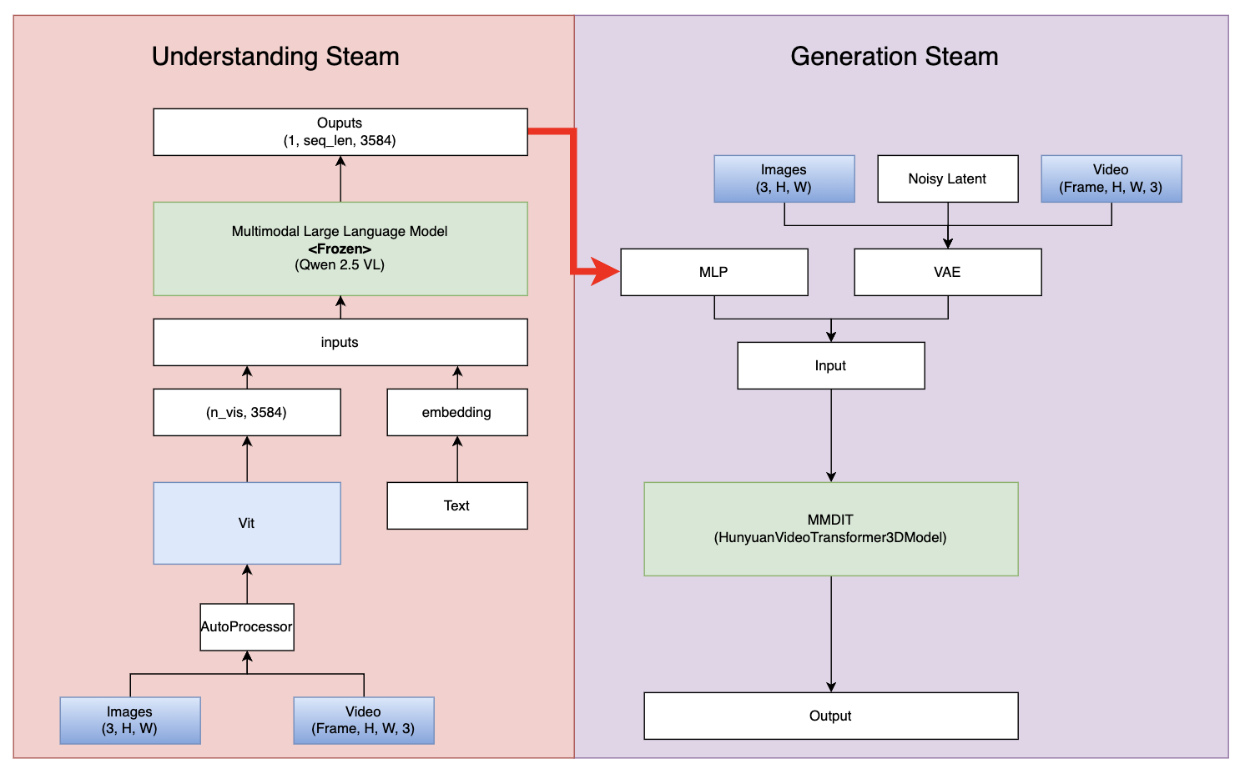
Notes:
Building on this dual-stream design, let’s look at how the two streams actually interact in the model.
🔴 Understanding Stream（左边）
On the left is the understanding stream.
Here, a pretrained MLLM takes multimodal inputs:
text
images
or videos
These inputs are first encoded, and then processed into a sequence of semantic tokens.
👉 These tokens represent:
what the user wants
what objects are involved
and the overall context
Importantly, this stream is frozen, so it keeps strong reasoning and language ability.
🟡 Connector（中间重点！！）
Now, these semantic tokens are not used directly.
They are passed through an MLP connector, which maps them into the generation space.
👉 This step is crucial, because: it aligns the understanding stream with the generation stream.
You can think of it as translating “language-level meaning” into “generation-ready features”.
🟣 Generation Stream（右边）
On the right is the generation stream.
Here, visual inputs are first encoded into latent space using a VAE.
At the same time, we also have noisy latent tokens, which represent the target video we want to generate.
Then both:
condition tokens
and noisy tokens
are fed into MMDiT.

Slide 5
How UniVideo Unifies Multiple Tasks
Architecturally, the multiple visual conditions are encoded, padded to a common format, concatenated along the temporal dimension, and then processed with self-attention.
That means the model can reason over all conditions jointly instead of hard-coding a custom path for each task.
Task Type | Inputs | Process
T2I (Text to Image) | MLLM: Text MM-DIT: noisy Imgae | text → conditioning noise → denoise → Image
I2V (Image to Video) | MLLM: image + text MM-DiT: image + noisy video | image + text → conditioning noise → denoise → video
T2V (Text to video) | MLLM: Text MM-DIT: noisy video | text → conditioning noise → denoise → video
Image Editing | MLLM: image + text MM-DiT: image + noisy image | image → structure text → edit instruction noise → denoise → image
ID-V2V (Video Editing) | MLLM: video + text MM-DiT: video + noisy video | video → structure + identity text → edit instruction noise → denoise → edited video
Notes:
Building on the dual-stream design,
this slide shows how UniVideo unifies different tasks.
The key idea is simple:
instead of building a different model for each task,
UniVideo uses the same interface for all tasks.
The model supports many tasks, such as:
text-to-image
text-to-video
image-to-video
video editing
image editing
Even though the tasks are different, the input format is always the same, they are all
- a text instruction
- and some visual inputs
The main idea is to treat everything as instruction following.
- Text tells the model what to do
- Visual inputs tell the model what to keep or change
this is like using one system for different molecule tasks, instead of building separate models for each case.
In the architecture, all visual inputs are:
encoded
padded to the same format
and concatenated along the time dimension
Then they are processed together using self-attention.
This means the model can:
look at all inputs together
and reason jointly

Slide 6
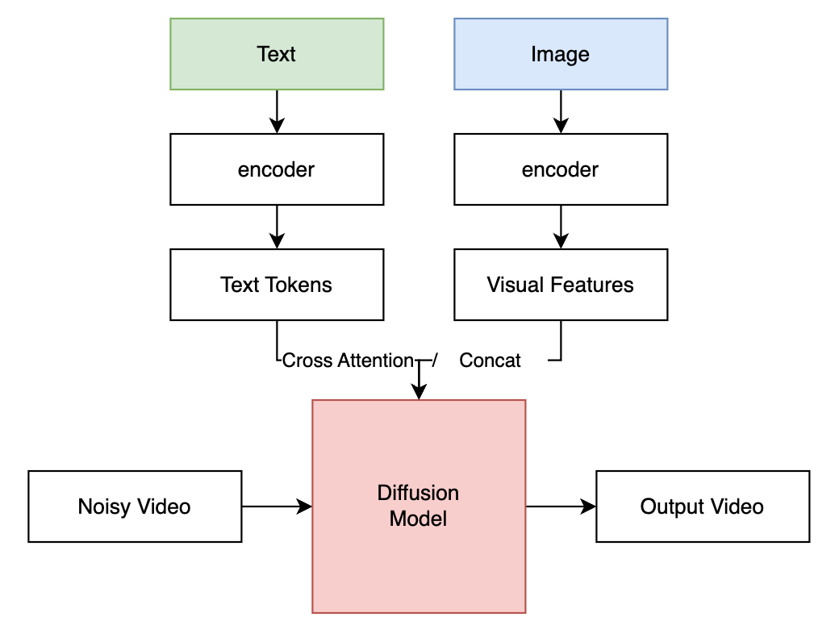
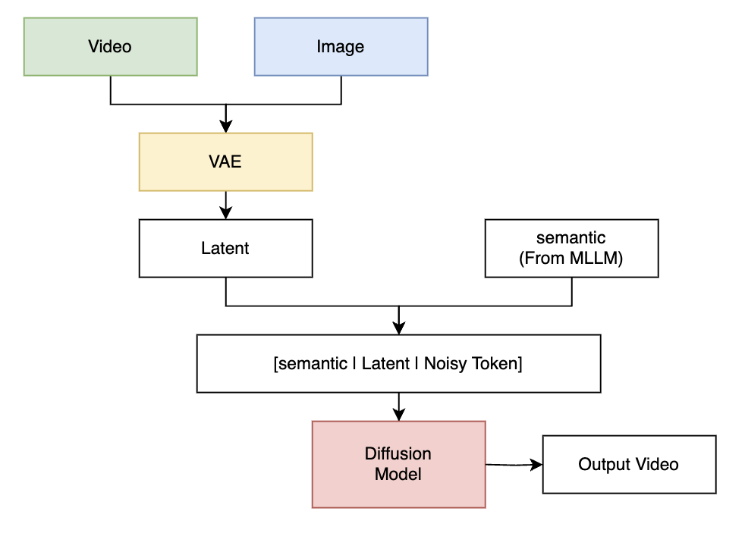
Conditioning Strategy for Video Inputs
Before
Condition Guides Generation
UniVideo
Condition Participates in Generation
Notes:
Next, let’s zoom in on the conditioning strategy for video inputs.
On the left is the traditional approach.
Here, text and image inputs are first encoded into features,
and then used to guide the diffusion model through cross-attention or concatenation.
On the right is UniVideo.
The key difference is that all inputs are brought into the same space.
Images are encoded into latent representations using a VAE,
and semantic information is extracted from the MLLM.
Then, these are combined with the noisy video tokens into a single sequence.
This means that instead of guiding the model from outside,
all information is processed together inside the diffusion model.
So now, the condition becomes part of the generation itself.

Slide 7
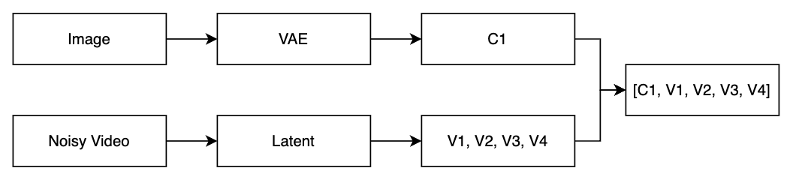
Conditioning Strategy for Video Inputs
Example: Input an Image, and produce a 4-frame video
Condition frames are treated as earlier timesteps in the video sequence.
Notes:
This slide gives an example of how UniVideo handles conditioning.
Let’s say the task is:
we input an image, and we want to generate a 4-frame video.
First, the image is encoded by the VAE into a latent representation, which we call C1.
At the same time, the noisy video is also converted into latent tokens,
which correspond to the target frames V1, V2, V3, and V4.
Now comes the key idea.
Instead of treating the image as a separate condition,
UniVideo places it directly into the video sequence.
So the final input becomes:
[C1, V1, V2, V3, V4]
This means the condition frame is treated as an earlier timestep in the sequence.
The model now sees everything as one continuous video.
Because of this, the model does not need special conditioning modules.
It can simply use self-attention to relate the condition frame to the generated frames.

Slide 8
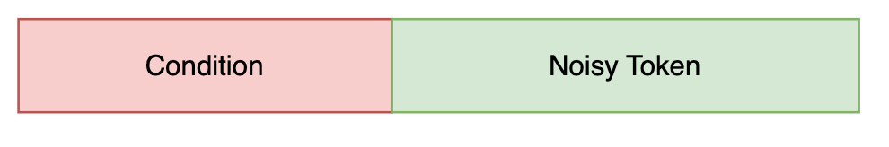
Positional Embedding for UniVideo
Input to MMDIT:
Question:
If the model does not know which frame is condition, how can the model avoid to edit the conditional frame?
UniVideo: 3D Positional Encoding
(token = content + positional_embedding(t, h, w)
Notes:
Now we move one step further.
After concatenating all tokens into a single sequence,
we face an important question:
If the model does not explicitly know which frames are conditions,
how does it avoid modifying them?
UniVideo solves this using 3D positional encoding!

Slide 9
Positional Embedding for UniVideo
Content = [0.2, -1.3, ...]
(t=2, h=10, w=20)
embedding = content + pos_t(2) + pos_h(10) + pos_w(20)
- Each token is encoded with a 3D position (t, h, w).
- Temporal position is embedded into the token, not provided as a separate input.
- This allows the model to distinguish condition frames from target frames.
Notes:
Each token is assigned a position based on three dimensions:
time (t)
height (h)
width (w)
So each token becomes:
👉 token = content + positional embedding(t, h, w)
The key idea is that condition frames and generated frames have different temporal positions.
Condition frames appear earlier in time,
while noisy tokens correspond to later timesteps.
Because of this, the model can learn:
which frames to read
and which frames to generate

Slide 10
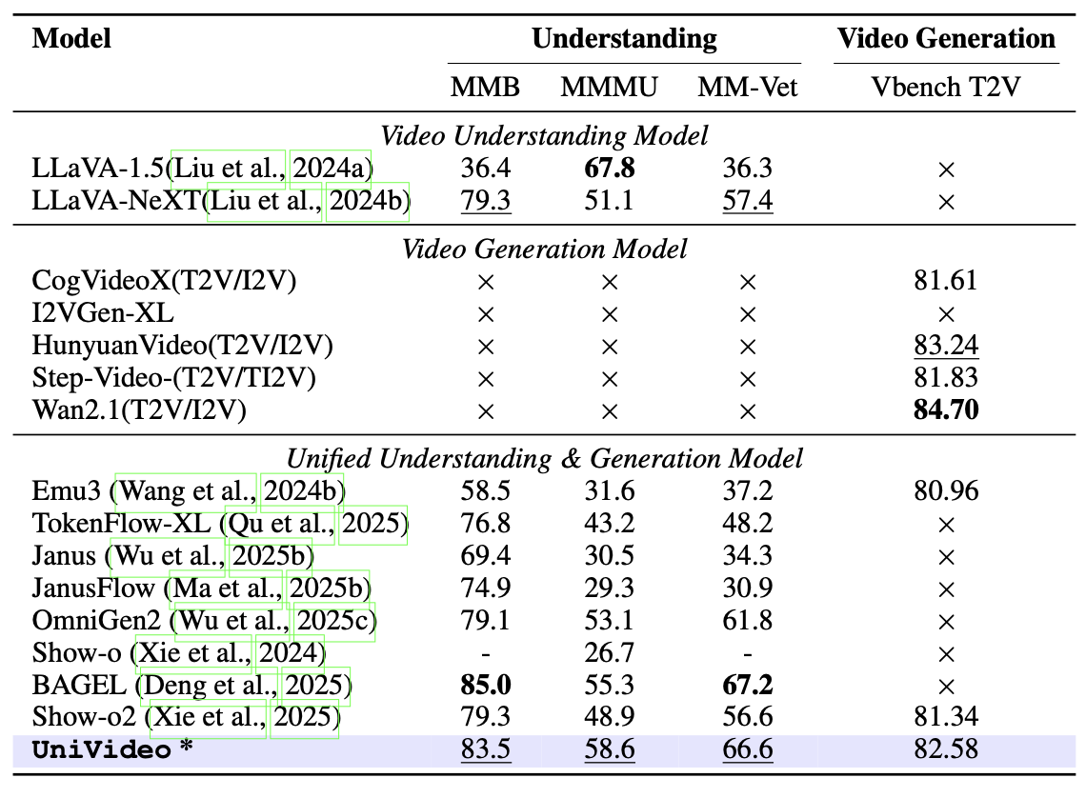
Main Results: Understanding and Generation
Notes:
Now let’s look at the main results.
This table compares different models on two aspects:
video understanding
and video generation
First, we can see that existing models are usually can only handle one task.
For example:
some models focus only on understanding
others focus only on generation
Because of this, they perform well on one task,
but cannot handle both at the same time.
Next, we look at unified models.
These models try to support both understanding and generation,
but their performance is still limited.
Now, focusing on UniVideo at the bottom.
We can see that:
👉 it achieves strong performance on both understanding and generation.
Compared to other unified models,
UniVideo shows better balance across tasks.

Slide 11
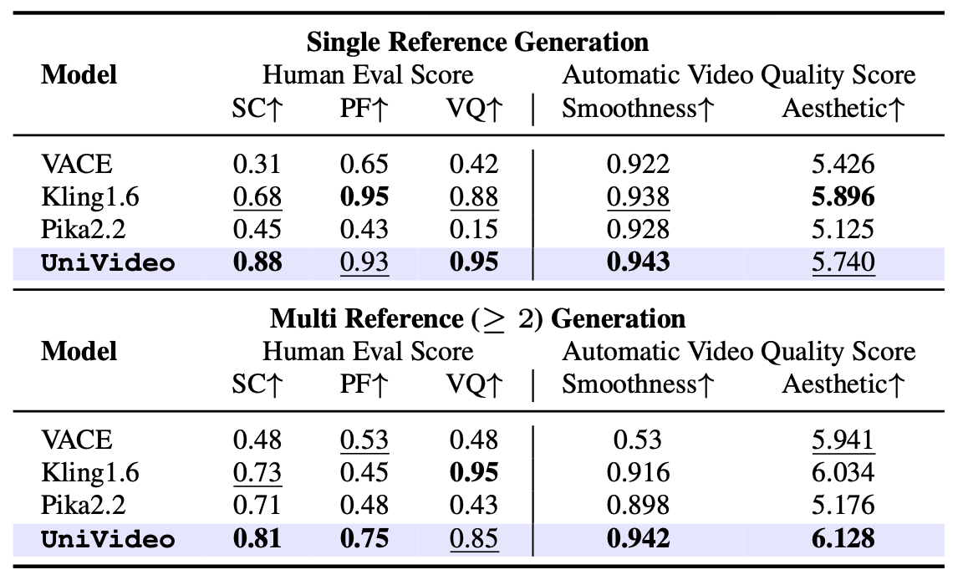
In-Context Video Generation Results
Notes:
Now let’s look at the in-context video generation results.
This table evaluates performance under two settings:
single reference
and multi-reference
In the single reference setting,
UniVideo achieves the highest scores on most socres.
Now looking at the multi-reference setting,
where the task is more challenging.
UniVideo still performs strongly,

Slide 12
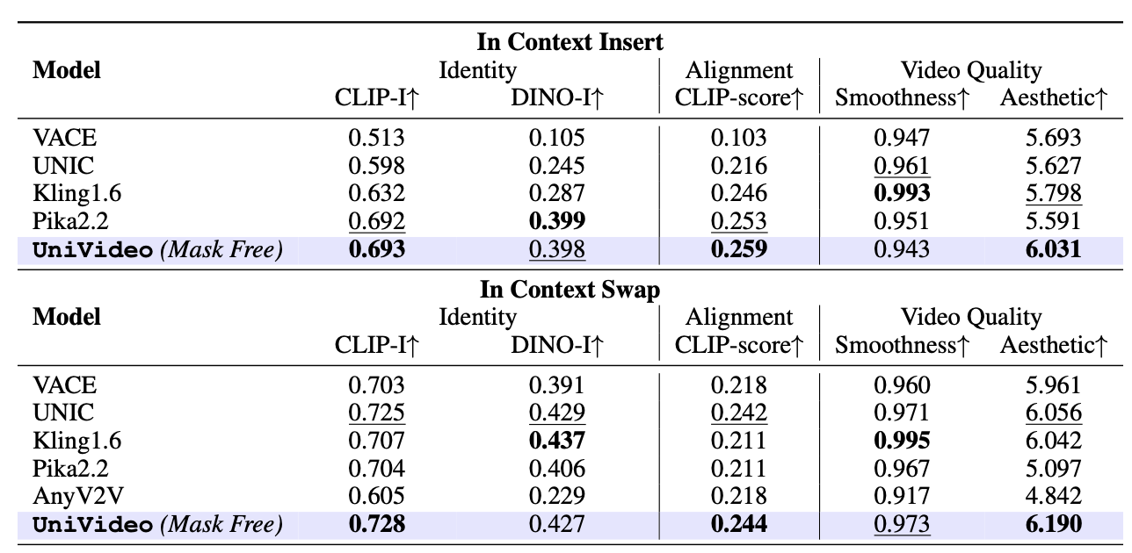
In-Context Video Editing Results
Notes:
Now let’s look at the in-context video editing results.
This table evaluates two types of editing tasks:
Insert and swap
🔹 Insert Task
In the insert setting,
the model needs to add new content into the video
while preserving the original identity.
We can see that UniVideo achieves:
the best CLIP-based identity score
and the highest alignment score
This means it can follow instructions
while keeping the original content consistent.
Now for the swap setting, which is more difficult because the model must replace content without breaking temporal consistency.
UniVideo again performs strongly.

Slide 13
Conclusion
Main Contribution
Key Strength
• A unified framework for video understanding, generation, and editing
• Reformulates generation as multimodal token modeling
• Introduces MMDiT with joint self-attention across conditions and targets
• Enables mask-free in-context video editing
• Strong multimodal alignment with frozen MLLM
• Handles diverse tasks with one shared architecture
• Effective use of multiple visual conditions
• Better instruction following and consistency
Limitations
• Relies on latent (2D) representation, limited 3D reasoning
• Performance depends on MLLM quality and alignment
• High computational cost for long video sequences
• Still limited in fine-grained control / precision editing
Notes:
Finally, let’s summarize the main contributions, strengths, and limitations of UniVideo.
The key contribution is a unified framework that supports video understanding, generation, and editing in one model.
Instead of designing separate pipelines, it reformulates everything as multimodal token modeling, and uses MMDiT to jointly process conditions and targets.
It also enables mask-free in-context editing, which simplifies the overall design.
One major strength is strong multimodal alignment while keeping the MLLM frozen.
The model can handle diverse tasks with a single shared architecture, and effectively combine multiple visual conditions.
This leads to better instruction following and consistency.
However, there are still some limitations.
The model mainly operates in latent 2D space, so 3D reasoning is limited.
It also depends on the quality of the MLLM, and can be computationally expensive for long videos.
Finally, fine-grained editing control is still not perfect.

Slide 14
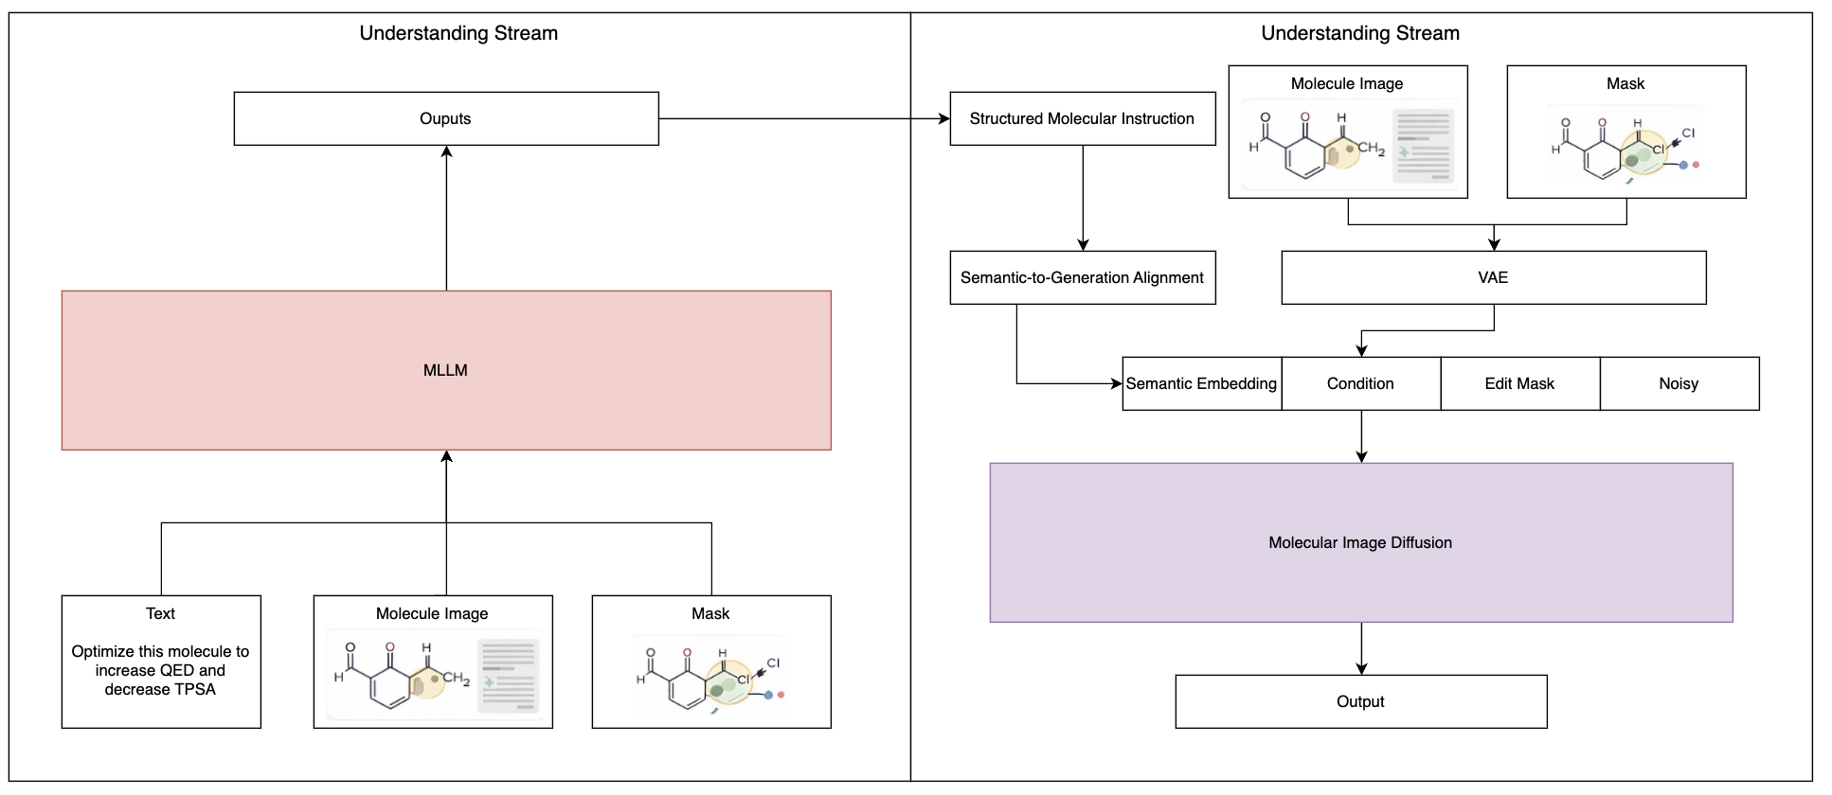
Combine with SketchMol
Notes:
So now, I want to briefly discuss how we can combine these two ideas.
The key idea is very simple. UniVideo is good at understanding complex multimodal instructions, while SketchMol is good at generating and editing molecules.
So we can combine them into one system.
The goal is to bridge human intention and molecular generation.
First, we have the understanding stream.
We take multimodal inputs, like text, molecule image, and mask.
Then we use an MLLM to understand the user’s intention.
For example, the user may say: increase QED and decrease TPSA.
Then, we introduce a key component, called semantic-to-generation alignment.
Then, we introduce a key component, called semantic-to-generation alignment.
This module converts high-level instructions into structured molecular operations.
For example, it identifies:
what is the task
what properties to optimize
which region to edit
what constraints to keep
So it bridges the gap between language and chemistry.
Finally, we use a diffusion model, like SketchMol.
The model takes:
semantic embedding
property conditions
mask
and noise
and generates the final molecule.

